Slide 1
Science 8
with Mr Bond
pbond@sd44.ca
bondsclasses.weebly.ca
tutorial times – after school at 3:00pm

Slide 2
The Key Concepts in Science
CHANGE - a conversion, transformation, or movement from one form, state, or value to another. Inquiry into the concepts of change involves understanding and evaluations causes, processes, and consequences.
SYSTEMS - sets of interacting components. Systems provide structure and order in human, natural, and built environments. Systems can be dynamic, simple, or complex.
RELATIONSHIPS - the connections between properties, objects, people, and ideas - including the human community’s connections with the world in which we live.

Slide 3
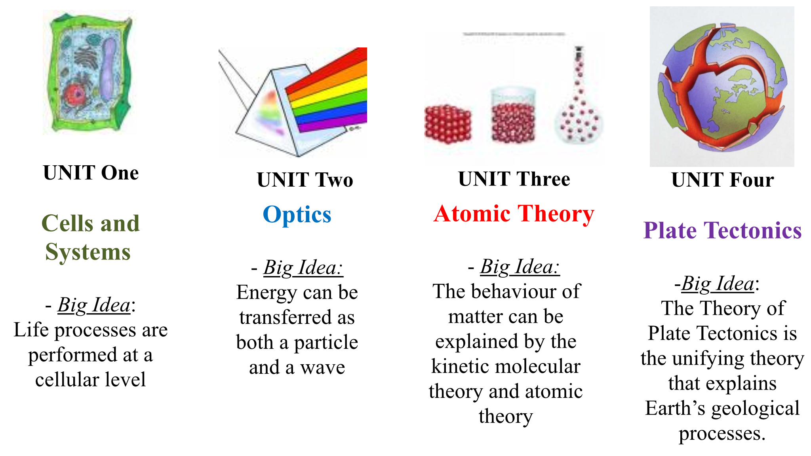
Big Ideas in Science
By the end of this course students will be expected to understand the following:

Slide 4
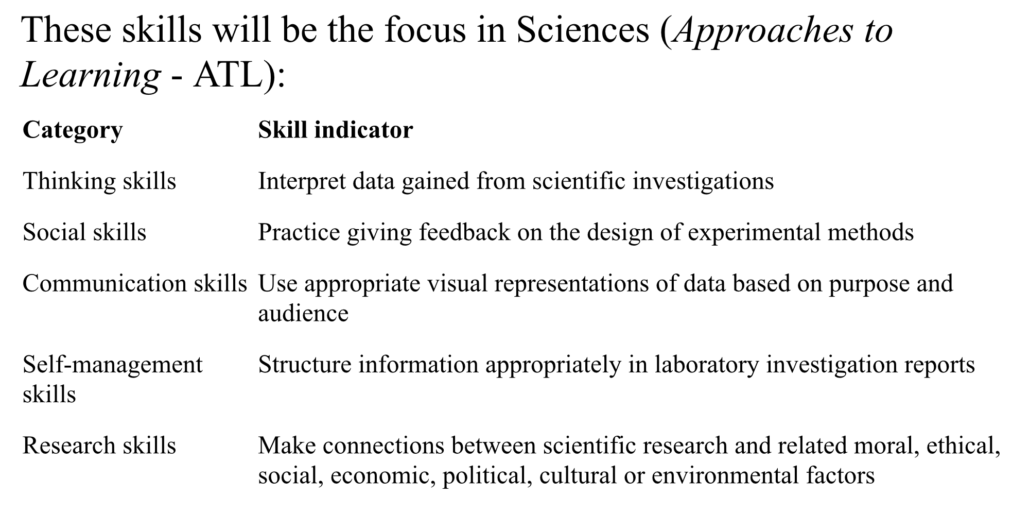
Approaches to Learning Skills (ATL)

Slide 5
Assessment
Carson Graham uses MYP style assessment – levels!
Formative vs Summative assessments
Projects and Tests near the end of each Unit
Lab Work and Skills will be a main focus
Final Exam/Assignment on last class

Slide 6
MYP style assessment
All assignments will be assessed in one or more of the following Criteria:
Criterion A – Knowledge and understanding
Criterion B – Inquiring and designing
Criterion C – Processing and evaluating
Criterion D – Reflecting on the impacts of science

Slide 7
MYP style assessment
All assignments will be assessed in one or more of the following Criteria:
TESTS
PROJECTS
Criterion A – Knowledge and understanding
Criterion B – Inquiring and designing
Criterion C – Processing and evaluating
Criterion D – Reflecting on the impacts of science
DESIGN LABS
REFLECTIONS
PROJECTS

Slide 8
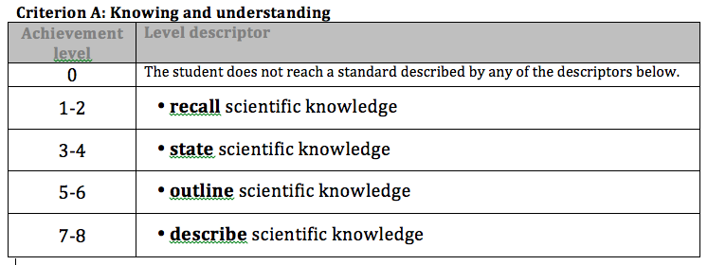
Each assignment is marked with rubrics from one or more Criteria
Each rubric has 8 levels
Notice the BOLD command terms

Slide 9
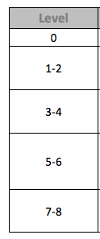
This is weird.
How do the levels work?
The levels match up with percentages and letter grades
Notice: Level 2 is a pass.
LEVEL | PERCENTAGE | GRADE
1 | 0 – 49 % | F
2 | 50 – 60 % | C
3 | 61 – 72 %
4 | 73 – 80 % | B
5 | 80 – 85 %
6 | 86 – 92 % | A
7 | 93 – 96 %
8 | 97 – 100 %

Slide 10
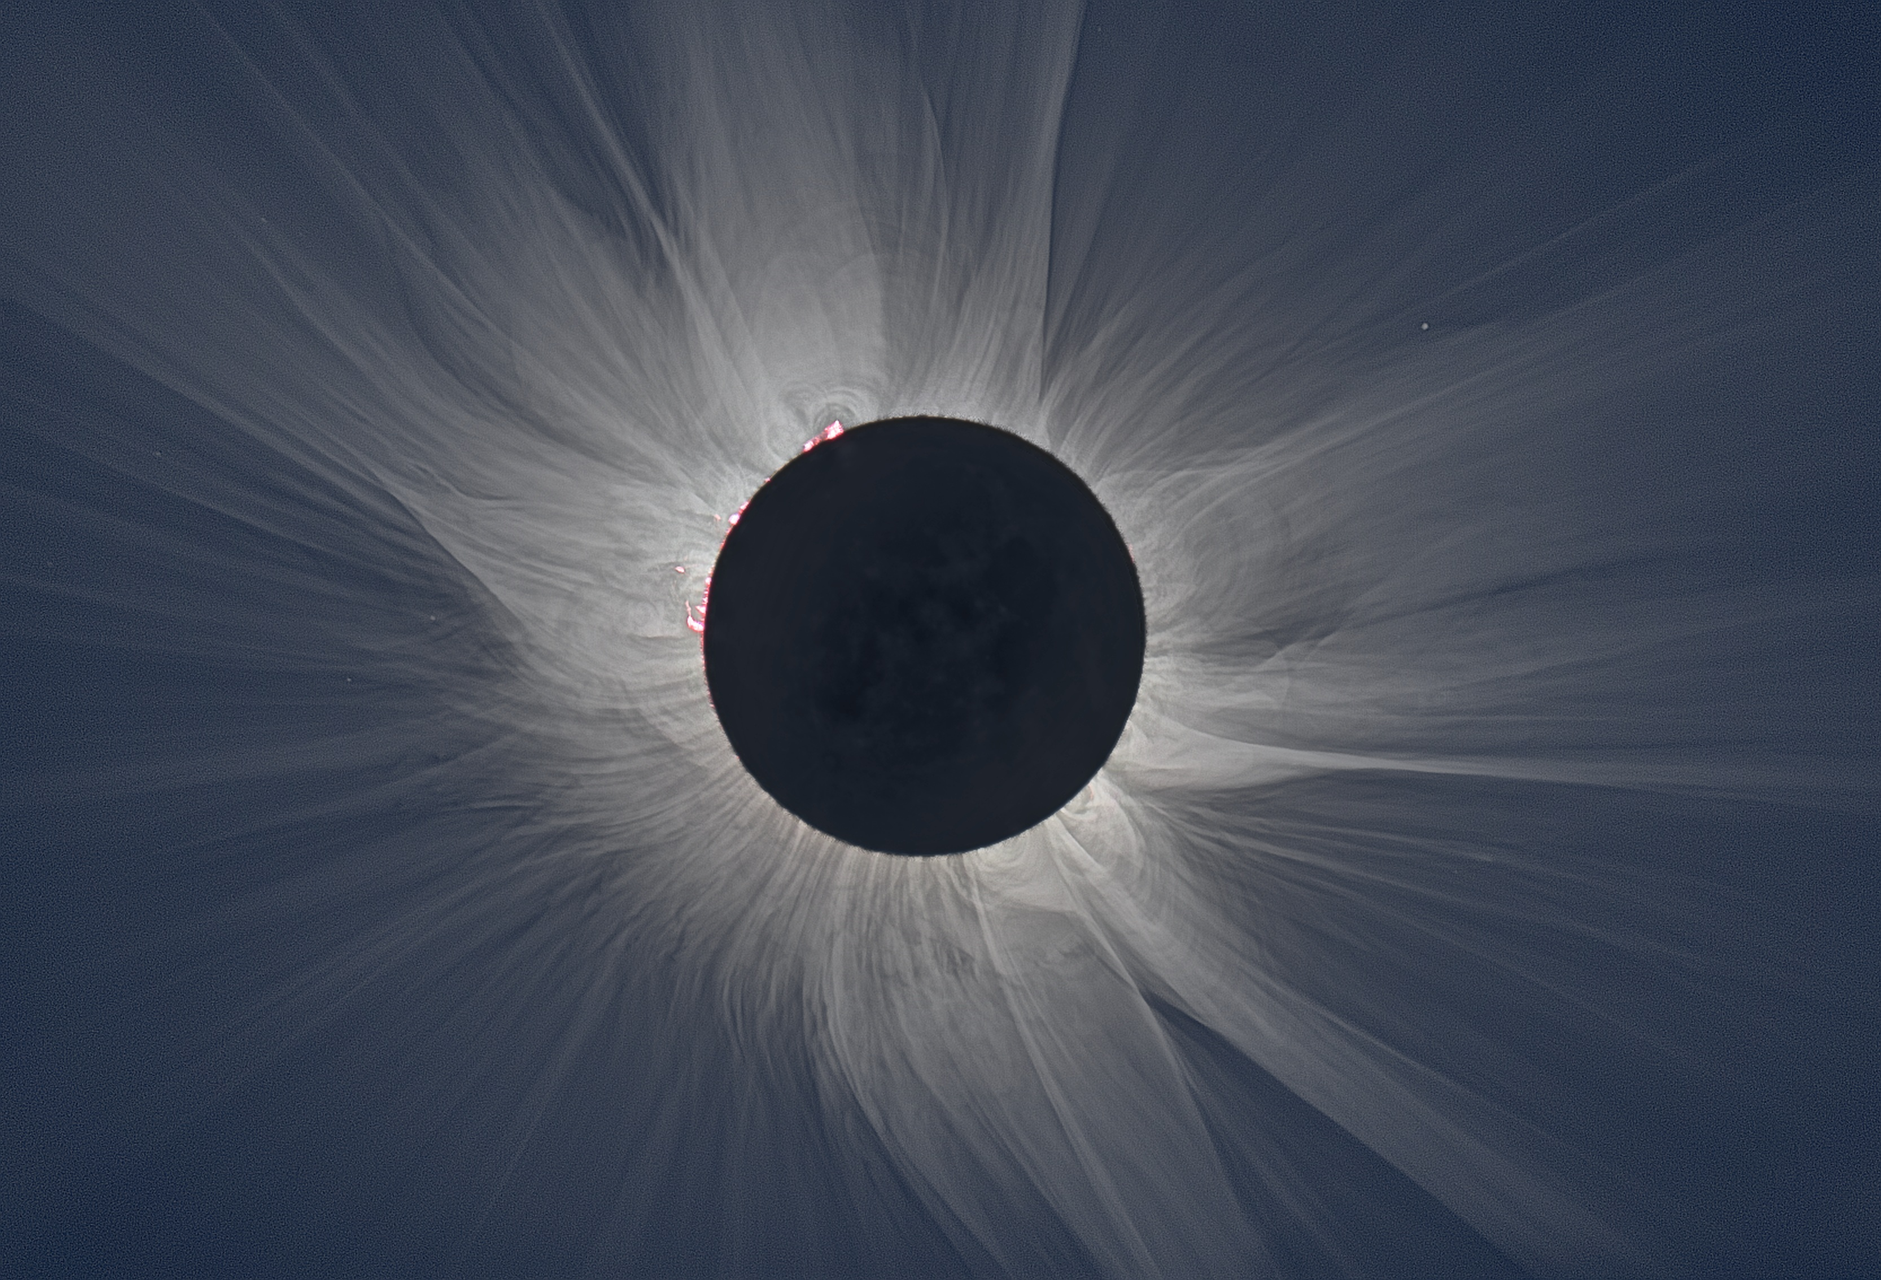
Questions?

