Slide 1
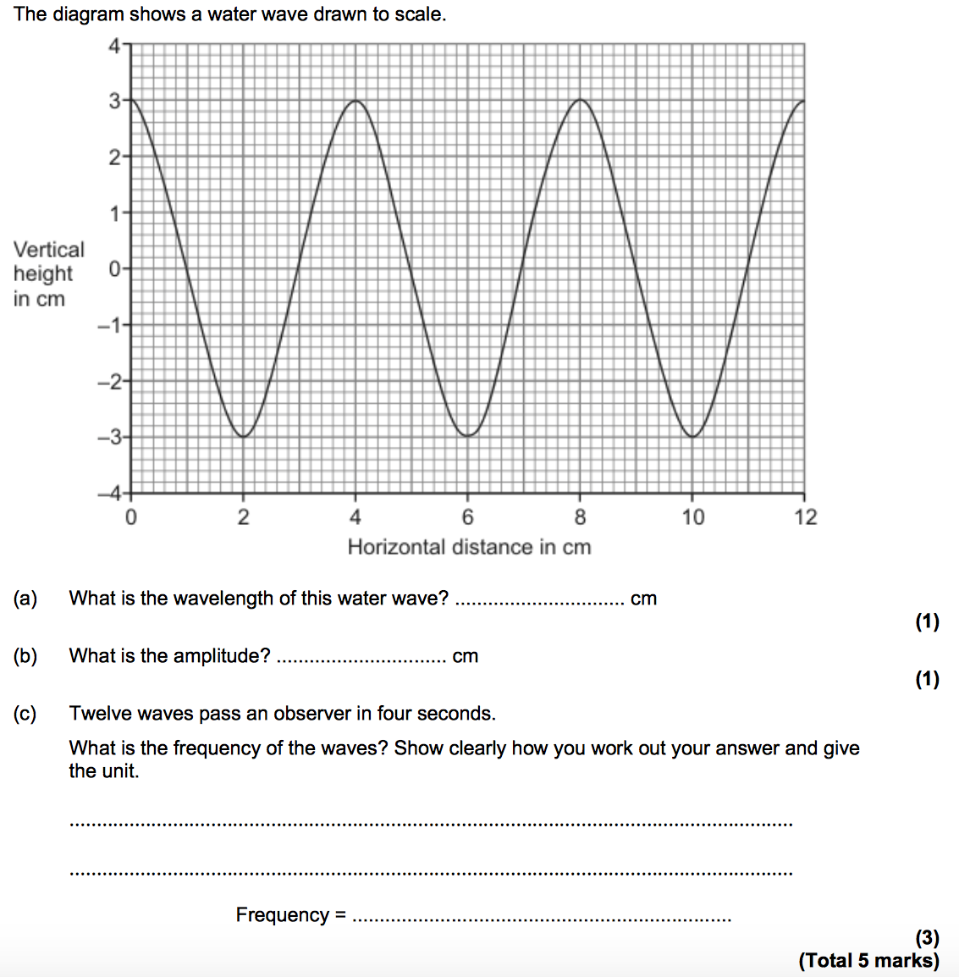
The anatomy of a wave
Symbol: Unit:
The _____________ of a wave is the maximum displacement of a point on a wave away from its undisturbed position.
Symbol: Unit:
The _______________ of a wave is the distance from a point on one wave to the equivalent point on the adjacent wave.
Trough
Peak
v =ƒλ
or
Frequency = no. waves
time
Wave speed = distance
time
Symbol: Unit:
The ______________is the speed at which the energy is transferred (or the wave moves) through the medium.
Symbol: Unit:
The _____________ of a wave is the number of waves passing a point each second.

